Slide 1


NOW Login with Active Directory
www.skaps.com

Slide 2
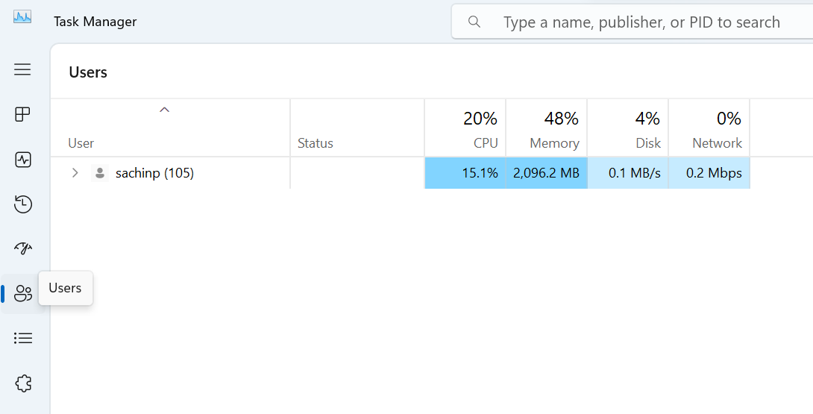
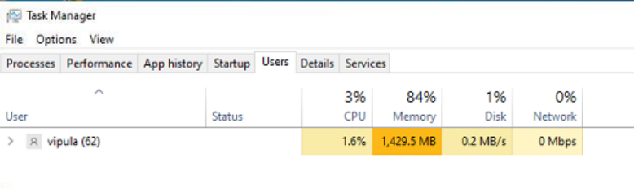
How to Find Laptop or Desktop User
Step 1 : Right click on Taskbar and click on Task Manger
Step 2 : Now go to user tab and find username
Windows 11 Task Manager
Windows 10 Task Manager
www.skaps.com

